Slide 1
Infectious Diseases
Malaria and Zika Virus

Slide 2
Malaria- Origins
Malaria is more complex than the other diseases we have discussed so far. It is caused by a protozoan, a single-celled organism whose genetic material is confined within a nucleus (unlike in bacteria). Its genome comprises about twenty-three million base pairs of DNA, thousands of times larger than the genomes of HIV and influenza.
First references to Malaria date back to first millennium BC in Greece and China

Slide 3
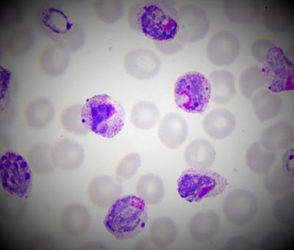

Slide 4
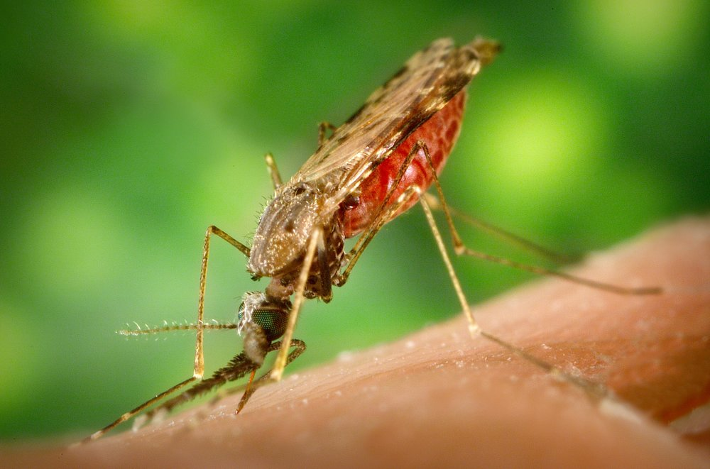
Malaria- Zoonotic Spillover
Malaria is transmitted from one human to another via various species of Anopheles mosquitoes
There are five species of
Malaria. Four commonly
infect humans, with one
found in macaques, though
monkey-to-human contact
has been observed.

Slide 5
Lifecycle of Malaria
All Malaria species have essentially the same lifecycle.
It starts with sexual reproduction in the gut of the mosquito host, after which it migrates to the salivary glands. It is injected into the human host when the mosquito bites. Once inside the human, it travels through the blood to the liver where it continues to reproduce, divide, and multiply, destroying red blood cells as the population grows.

Slide 6
Malaria- Locations
Malaria typically is found in warmer regions of the world. Malaria parasites need warmth to complete their growth before they are mature enough to be transmitted to humans.
Malaria occurs in more than 100 countries and territories. About half of the world’s population is at risk. Areas of Africa, South Asia, South America, the Caribbean, the Middle East, and Oceania are considered areas where Malaria transmission occurs.

Slide 7
Malaria- Fatality Rate
There were 241 million cases of Malaria in 2020
The estimated number of Malaria deaths stood at 627 000 in 2020

Slide 8
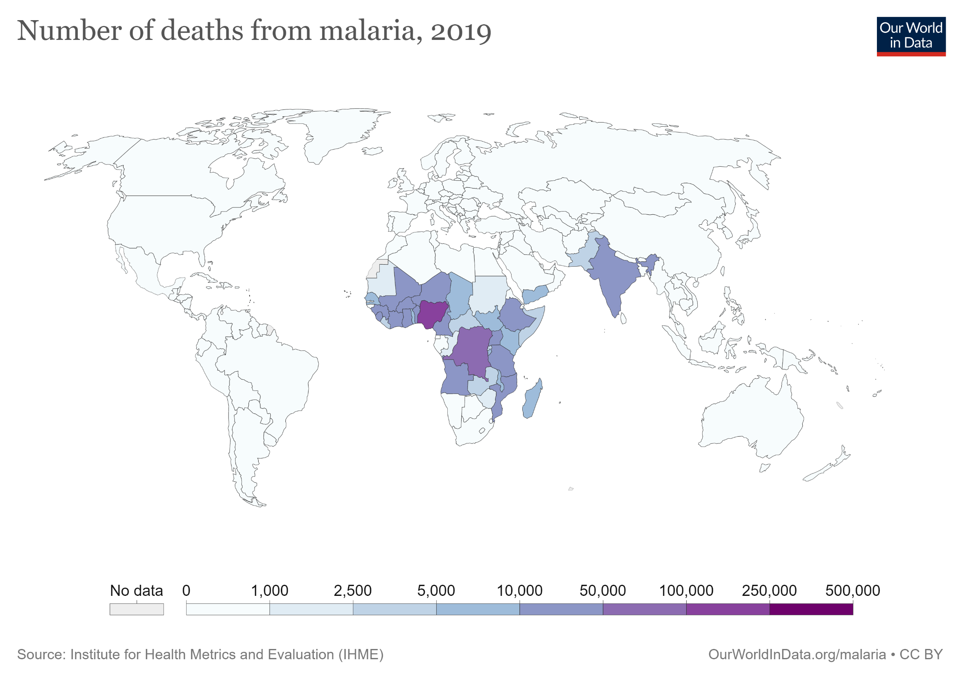

Slide 9
Malaria- Spread in the body
Incubation: 7-30 days.
Malaria adjusts itself to multiple organs within each host e.g. blood, liver, salivary glands, gut.

Slide 10
Malaria- Signs and Symptoms
Malaria causes anaemia by destroying red blood cells. However, the worst symptoms occur when Malaria get into the brain, causing Cerebral Malaria.
In Cerebral Malaria, parasites block blood flow and trigger inflammation, killing untreated patients or causing brain damage in patients that are treated and recover.

Slide 11
Malaria- Signs and Symptoms
Malaria’s most obvious symptom is fever.
In many Malarial regions, patients who come to the hospital with fever and headache are automatically treated for Malaria since testing is expensive and requires expertise.

Slide 12
Malaria- treatment and cost
The most common antimalarial drugs include:
Chloroquine phosphate: preferred treatment for any parasite that is sensitive to the drug. But in many parts of the world, parasites are resistant to chloroquine.
Artemisinin-based combination therapies: a combination of two or more drugs that work against the Malaria parasite. This is usually the preferred treatment for chloroquine-resistant Malaria.
The cost of treating uncomplicated Malaria was $5.84 and the cost of treating severe Malaria was $30.26

Slide 13
Global Malaria Eradication Program
The Global Malaria Eradication Program, which began in 1955 and aimed to eradicate Malaria by 1963, encountered many problems. The biggest was the campaign push for the use of DDT and the devastating effects on wildlife (especially birds).
Once the link was made between wildlife deaths and DDT usage by Rachel Carson’s Silent Spring (1962) a push for the banning of DDT started, and was successful.

Slide 14
Malaria- vaccination
The only approved vaccine, as of 2021, is Mosquirix.
In October 2021, the WHO for the first time recommended the large-scale use of a Malaria vaccine for children living in areas with moderate-to-high Malaria transmission.
No data on how many people have been vaccinated against Malaria.

Slide 15
Malaria- Risk Factors
The greatest risk factor for developing malaria is to live in or to visit areas where the disease is common. The degree of risk depends on local malaria control, seasonal changes in malaria rates and the precautions you take to prevent mosquito bites.
People at increased risk of serious disease include:
Young children and infants
Older adults
Travelers coming from areas with no malaria
Pregnant women and their unborn children

Slide 16
Malaria- Diagnosis
Malaria parasites can be identified by examining under the microscope a drop of the patient's blood, spread out as a “blood smear” on a microscope slide.
Prior to examination, the specimen is stained to give the parasites a distinctive appearance.

Slide 17
Zika- Origins
Zika virus was first discovered in 1947 and is named after the Zika Forest in Uganda
Due to its more mild nature, not much effort has gone into back-tracing Zika to find its Spillover origins, and therefore the first case is still listed as 1947.

Slide 18
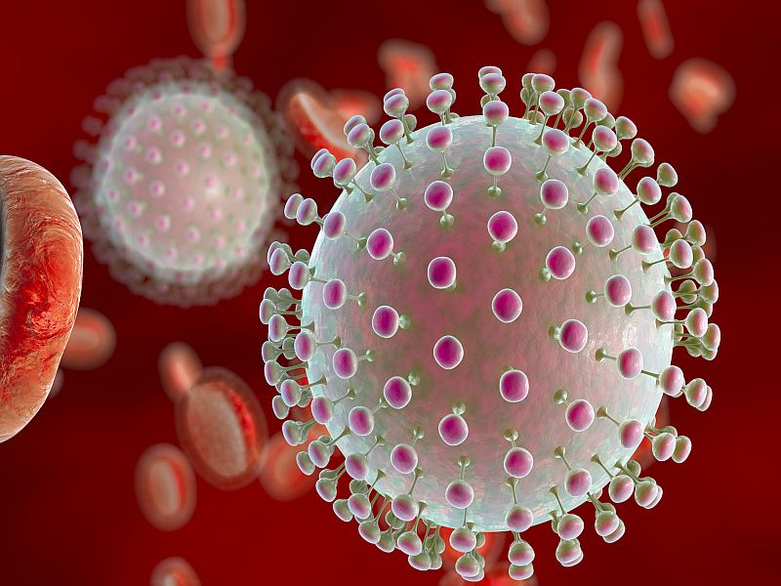

Slide 19
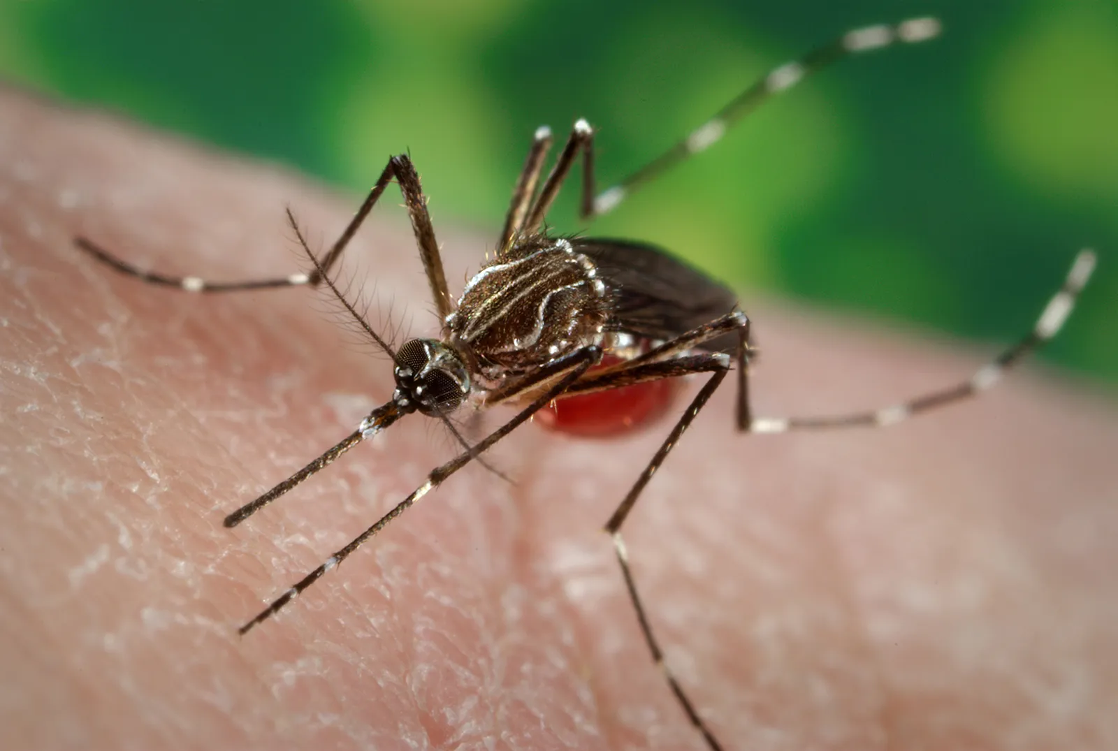
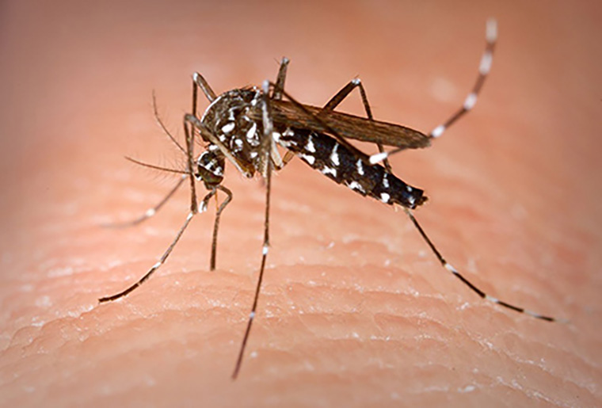
Zika- Zoonotic Spillover
Aedes aegypti and Aedes albopictus

Slide 20
Zika- Locations
Zika virus occurs in tropical areas with large mosquito populations and is known to occur in Africa, the Americas, Asia and the Western Pacific.

Slide 21
Zika- Signs and Symptoms
Incubation: 3-12 days
Infection is characterised by fever, joint stiffness, headache, conjunctivitis, and a rash that spreads from the face to the rest of the body.
Zika can be transmitted sexually, via blood transfusion, and passed from mother to child during pregnancy.

Slide 22
Zika- Fatality Rate
Zika is milder than Dengue and Malaria
Death rate is 0.05%

Slide 23
Congenital Zika syndrome
Zika virus can be transmitted from mother to foetus during pregnancy, resulting in microcephaly (smaller than normal head size) and other congenital malformations in the infant, collectively referred to as congenital Zika syndrome.
Microcephaly is caused by underlying abnormal brain development or loss of brain tissue.

Slide 24
Zika- treatment
There is no specific treatment for infection with the Zika virus. To help relieve symptoms, get plenty of rest and drink plenty of fluids to prevent dehydration. The over-the-counter (OTC) medication acetaminophen (Tylenol, others) may help relieve joint pain and fever.

Slide 25
Zika- Spread
Tropical and subtropical regions are at risk, as well as any regions that support the mosquito.

Slide 26
Zika- Risk Factors
Living or traveling in countries where there have been outbreaks: being in tropical and subtropical areas increases your risk of exposure to the Zika virus.
Having unprotected sex: the Zika virus can spread through sex. Pregnant women whose sex partners recently lived in or travelled where Zika virus is common should use a condom during sexual activity or abstain until the baby is born. All other couples can also reduce the risk of transmission by using a condom or abstaining for up to three months after travel.

Slide 27
Zika- Diagnosis
Detection of Zika virus genetic material (PCR testing): This test looks for evidence of the genetic material (RNA) of Zika virus.
The test is most sensitive in the first 7 days after symptoms start when performed on blood, and in the first 14 days when performed on urine.

Slide 28
Spillover- Zika, Ebola and Beyond
https://www.youtube.com/watch?v=0dA-Ls9Iw24

